Slide 1
Eye Color
Blue
Green
Brown
Gray or Hazel
Hair Color
Black
Blonde
Brown
Red
Gray

Slide 2
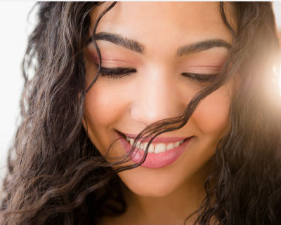
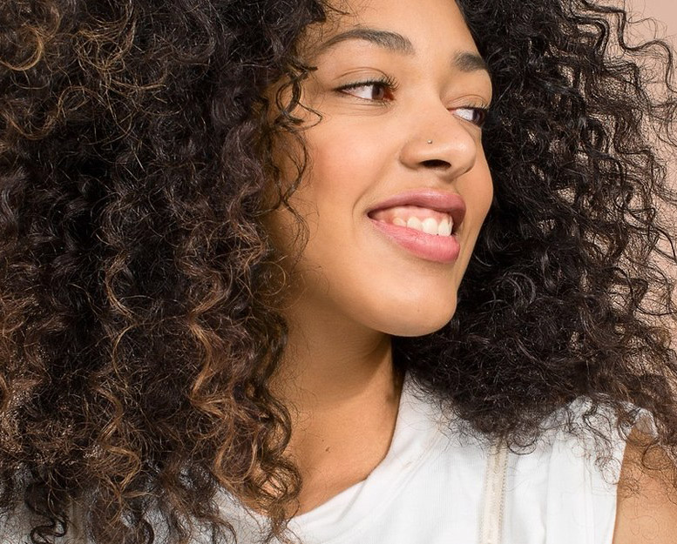
Hair Type
Straight
Wavy
Curly
Handedness
Left-Handed
Right-handed

Slide 3
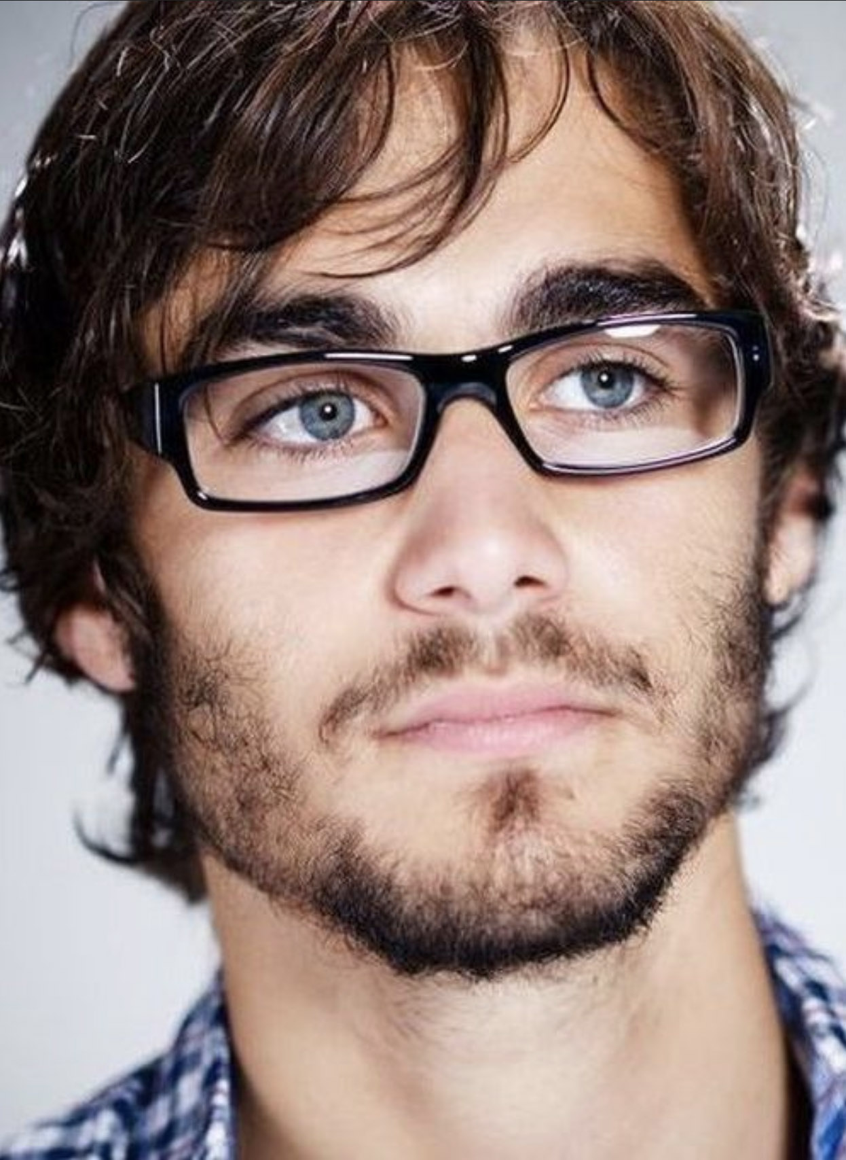
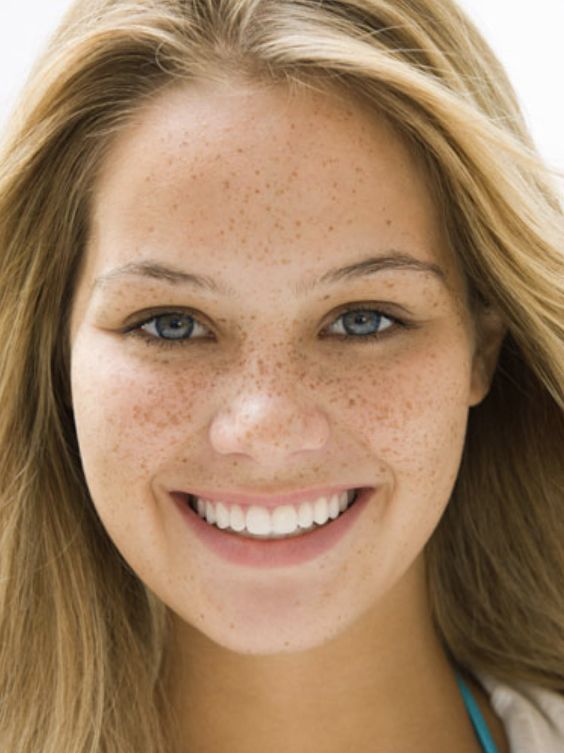
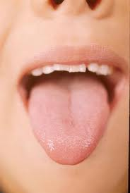
Freckles
No Freckles
Freckles
Clear Bead
Tongue Rolling
Roller
Non-Roller
White Bead

Slide 4
Dimples
Dimples
No Dimples
Item | Characteristic | Phenotype | Frequency
Sea Green Pearl Beads | Eye Color | Gray/Hazel eyes | 5-8%
Green Beads | Eye Color | Green eyes | 2%
True Blue Beads | Eye Color | Blue eyes | 8%
Medium Brown | Eye Color | Brown eyes | 50-55%
Silver Glitter Beads | Freckles | Freckles | Low
Clear Beads | Freckles | No freckles | Majority
Light Blue Beads | Gender | Male | 49%
Pink Opaque Beads | Gender | Female | 51%
Yellow Beads | Hair Color | Blonde hair | 2%
Khaki Beads | Hair Color | Brown hair | 2nd most common
Rust Beads | Hair Color | Red hair | 2%
Black Beads | Hair Color | Black hair | Most common
Neon Red Beads | Hair Type | Straight hair | 45%
Plum Beads | Hair Type | Curly hair | 55%
Light Green Beads | Hair Type | Wavy Hair | Low
Lime Opaque Beads | Handedness | Left handed | 10%
Hot Pink Opaque Beads | Handedness | Right handed | 90%
White Beads | Tongue Rolling | Non-rolled tongue | 19-35%
Yellow Transparent Beads | Tongue Rolling | Rolled tongue | 65-81%
Pipe Cleaners |  |  | All
Supplies are available online at amazon.com and ponybeadstore.com, or from a local Michaels or Hobby Lobby, etc.

