Slide 1

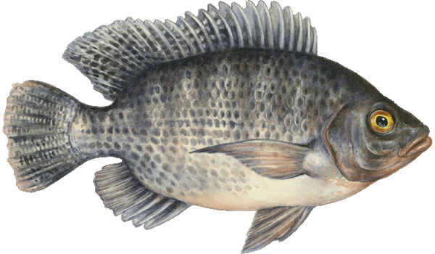
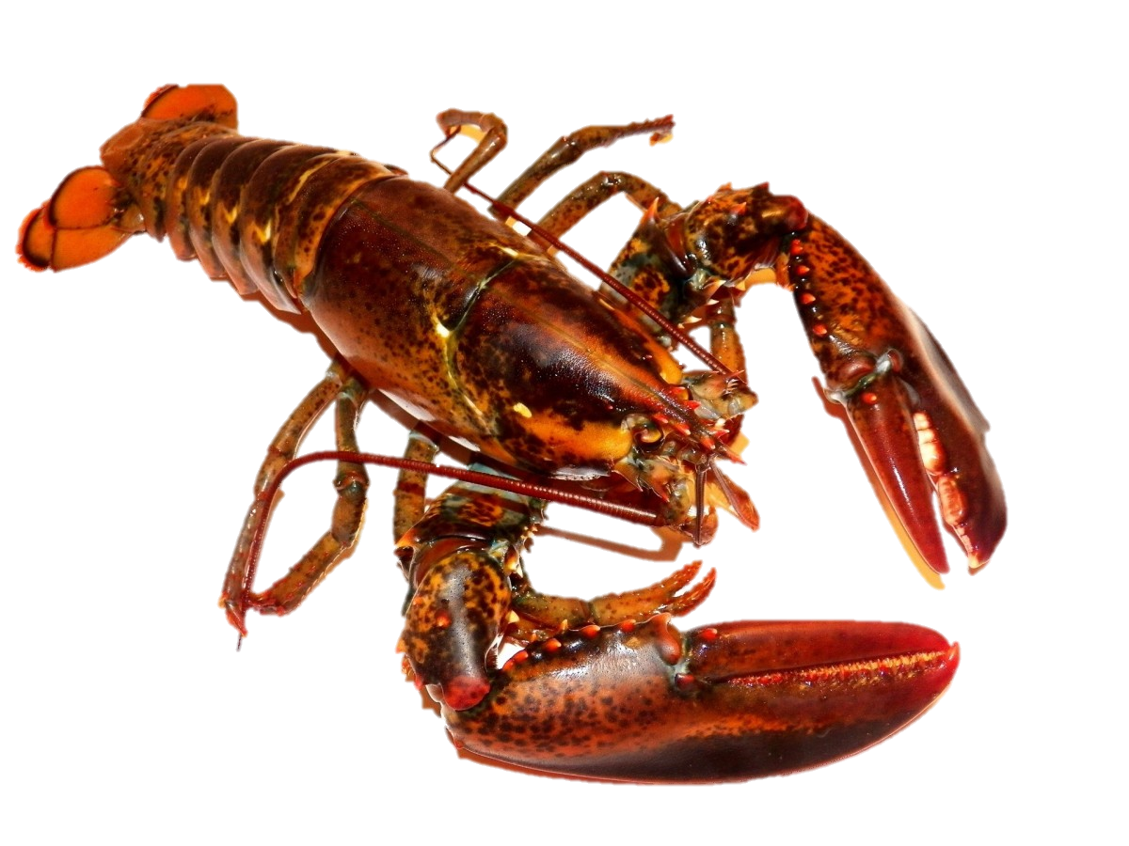

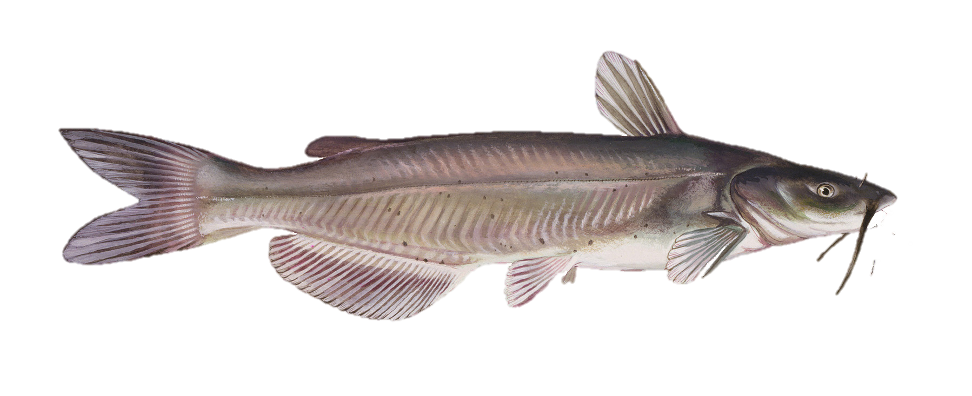
Classroom Aquaponics
Dr. Michael Bechtel, Sadie Short, Becca Montgomery, Sidney Baumgartner
Department of Biology, Wartburg College, Waverly, Iowa, 50677
PHASE I:
Introduction
The original focus of the Aquaponics Project (2016) was to gain valuable information for the sustainability of an aquaponics system. Founded primarily as a humanitarian endeavor, the purpose of this project was to create a hands-on, self sufficient food system. This system would utilize fauna to produce nitrogenous waste (ammonia) in high enough volumes to sustain vegetative growth. Through the use of aerobic bacteria, the ammonia from fish waste would be converted into nitrates (readily taken up and used by terrestrial plants) which in turn would vastly improve overall plant growth.
Investigation
The largest reservoir (300 gallons) was used to house all Blue Tilapia (Oreochromis aureus) within the system, 63 in total. The tilapia were fed a manufactured pelletized diet to support growth and produce waste. A stand pipe in the rear corner of the tank pulled out a majority of the nitrogenous waste which naturally accumulated at the bottom of the reservoir.
The waste then flowed into a 45-gallon reservoir used to house 10 Red Claw Crayfish (Cherax quadricarinatus), which acted as bottom feeders. The crustaceans received supplemental feeding through pelletized food while they also consumed solid waste transferred from the first reservoir. The end material became appropriately sized pieces for extraction to the bio filter. Floating grow-beds, atop the this reservoir, and the accumulating solid material on bottom provided an ideal environment for crayfish to live and reproduce. Overflow from this tank traveled into a double bio-filter system.
The dual bio-filter system contained plastic mesh which captured solids and provided a place of adherence for bacteria. The bacteria converted the waste (ammonia) into nitrates. The use of two bio-filters proved beneficial as solids accumulated quickly on the mesh which created an anaerobic area in single filter systems not suitable for nitrate conversion.
The bio-filter system then overflowed into a sump reservoir containing an aquarium pump which cycled water into the grow-beds. The cycled water – then rich in nutrients – fertilized the plants, accelerating growth. The grow-beds emptied back into the tilapia tank, beginning the cycle anew.
Implications
Plants took less than 2/3 of the normal time to grow compared to conventional soil farming, allowing for faster yields and production. A closed-loop recirculating system lost less water than conventional soil farming. Water loss is caused primarily by transpiration and evaporation. Reduction of surface area conserved about 90-95% of the water in the system. Pesticide use was eliminated as vegetation did not come in to contact with typical terrestrial pests. The system produced fauna and vegetation year round when in a stable, indoor environment. Fresh food was produced on-site and did not require processing.
PHASE II:
Introduction
After finding the apparatus to be an effective learning and teaching tool, the new extended focus of the Aquaponics Project (2017) was to bring exceptional learning opportunities to the classroom. Aquaponics combines several tested educational theories together, including: biophilia (E.O. Wilson, 1984), overarching phenomena (Next Generation Science Standards), and active learning (Revans, 1990). Aquaponics provides hands-on opportunities applicable to all STEM fields, leading Wartburg College to reach out to local education institutions and interested individuals.
Investigation
Connections were forged with a local high school senior, Noah Solheim, and a local sixth grade teacher, Mr. Travis Angell. At the time, Solheim was conducting individual research, while Angell was incorporating aquaponics into his classroom. Both individuals collaborated in an effort to create smaller scale aquaponics systems usable in an educational setting.
The aquaponics systems ranged from 10-gallon pre-fabricated window units to 40-gallon DIY experimental units. All created systems were smaller than the college’s 300-gallon+ system. The smaller units mandated smaller species of fish, but were proven to easily house: guppies (Poecilia reticulate), endlers (Poecilia wingei), mollies (Poecilia sphenops), platies (Xiphophorus maculatus), swordtails (Xiphophorus hellerii), and goldfish (Carassius auratus). Smaller units had limited success providing for fruit or leaf producing agriculture plants due to size and nutrient restrictions.
The conducted experiments were open-ended and self-driven. No curriculum existed for the building, or the use of, the aquaponics system at this time. Several students at varying levels were interested in particular components of the systems and created their own models as well.
Implications
Aquaponics has connections to all STEM fields and could be used by several core practices simultaneously. Running the system involves both academic and psychomotor skills. Cost and size can be a limiting factors for incorporating aquaponics into the classroom. A 300-gallon tank is not appropriate for most secondary classrooms. Systems must be matched with educational level to sustain interest and involvement. Small units may not properly engage secondary students. Support in the form of communication is important to foster ideas for modifications and improvements.
Model
Primary Consumer
Ammonia Waste
Growth
Aquaponics
Aerobic Bacteria
Fauna
Primary Producer
Nitrates
PHASE III:
Introduction
The final iteration of the Aquaponics Project (2018) involved the combination of all prior research into a cohesive educational tool. Three different systems were developed for specific educational levels: 1) pK-5 aligns with the 2-gallon container size, 2) 6-8 fit well with a 30-gallon table top size, and 3) 9-12 function appropriately with a 75-gallon floor model. Thirty cross-curricular and NGSS-aligned lesson plans were crafted to be used along side these systems at a high school level, with current endeavors to develop lesson plans for the middle and elementary levels.
Tilapia
Oreochromis aureus
Red Claw
Cherax quadricarinatus
Catfish
Ictalurus punctatus
Acknowledgements
We would like to take this opportunity to thank Mr. Ryan Henkel for igniting a passion of aquaponics in his professor. Special recognition is due to Mr. Travis Angell (Waverly-Shell Rock science instructor), Eric Berns (Science Center coordinator), and Noah Solheim for their help forming the connections between the undergraduate level and secondary/middle schools. This program would not exist as it is today without their contributions. We also would not be where we are today without our community supporters like Mr. Derek Happel. There are many assistants that also deserve mention including Zack Pogorzelski, Angelina Carrasquillo, Candace Baker, Jean Hakizimana, Evan Van Vleck. Lastly, we would like to thank the Wartburg College IACUC for allowing us to perform research with animals.

